Slide 1
Paper and code analysis of Global and Local Kernels for Recommender Systems
Md. Baker, ID- 1911672642
Kazi Kaarima Nashia, ID-2031176642
Fatema Akter Rimi, ID-2021930042

Slide 2
Github link
https://github.com/usydnlp/Glocal_K?fbclid=IwAR2Ep8jdl58xI2pnhlSTQEdWlFScbpNxpHl9UznOVUXjm2YXUyzYuo_gP

Slide 3
Motivation
Recommender systems often deal with high dimensional sparse user-item matrix
For a system to predict a user’s interest, it becomes imperative to complete these matrices
Hence, this paper proposed a Global Local Kernel based matrix completion framework named GLocal-K

Slide 4
Aim of this paper
To represent high dimensional sparse user item matrix into low dimension with a small number of important features
This will be achieved by GLocal K framework
Next , to improve the feature extraction performance for a high dimension user-item rating matrix into low dimensional latent feature space
To extract the features, 2 kernels are used: local kernel and global kernel

Slide 5
2 major stages of GLocal K
Pretrain an autoenoder
Fine tune the pre-trained auto-encoder

Slide 6
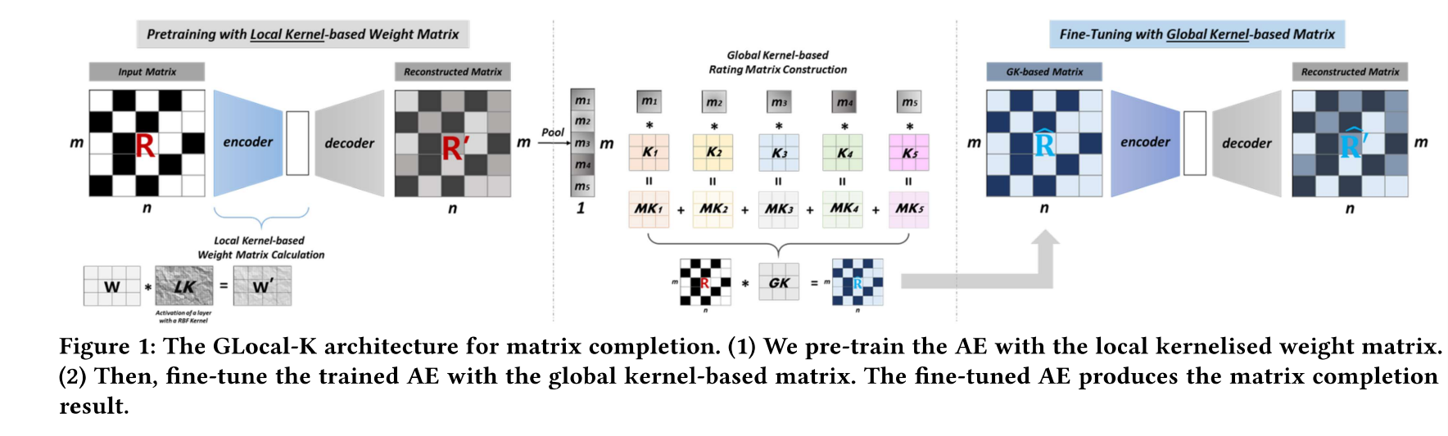
Diagram of the process

Slide 7
Implementation of each of these stages

Slide 8

Stage1: Pretrain an autoencoder
Each item vector r_{i} are inputs to item based autoencoder and gives the reconstructed vector r_{i} prime to predict the missing ratings
The model is given by:
Where 𝑊^ (𝑒) ∈ R^ (ℎ×𝑚) and 𝑊 ^ (𝑑) ∈ R^ (𝑚×ℎ) are weight matrices,𝑏 ∈ R^ ℎ and 𝑏 ′ ∈ R^ 𝑚 are bias vectors, and 𝑓 (·) and𝑔(·) are non-linear activation functions.

Slide 9

Continuing
The weight matrices in an autoencoder are reparametrized to generalize weight matrices by RBF Kernel
The RBF is defined as:
Here ,K is a kernel function which computes the similarity between two vectors U and V
After this, the next step will be to compute the local kernelized matrix

Slide 10

Computing local kernelized matrix
The dot product of weight matrix and kernel function will give local kernelized matrix

Slide 11
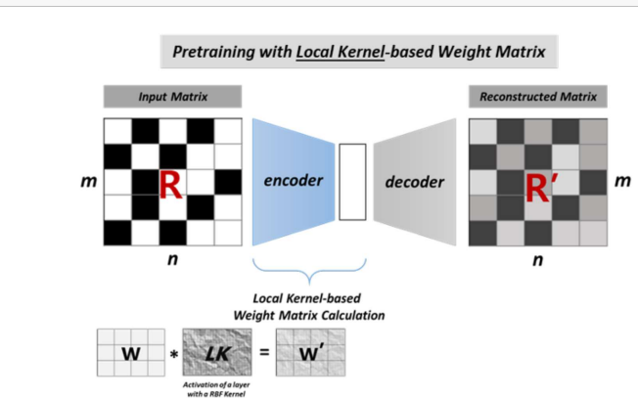
Diagram of stage 1

Slide 12
Intermediate stage
In this stage, the output of the decoder( in this case, rating matrix)
is passed to pooling to summarize the information of each item
The kernels are aggregated
These aggregated kernels are used as global convolution kernel
Global kernel based convolution operation is applied to user rating matrix for global kernel based feature extraction

Slide 13
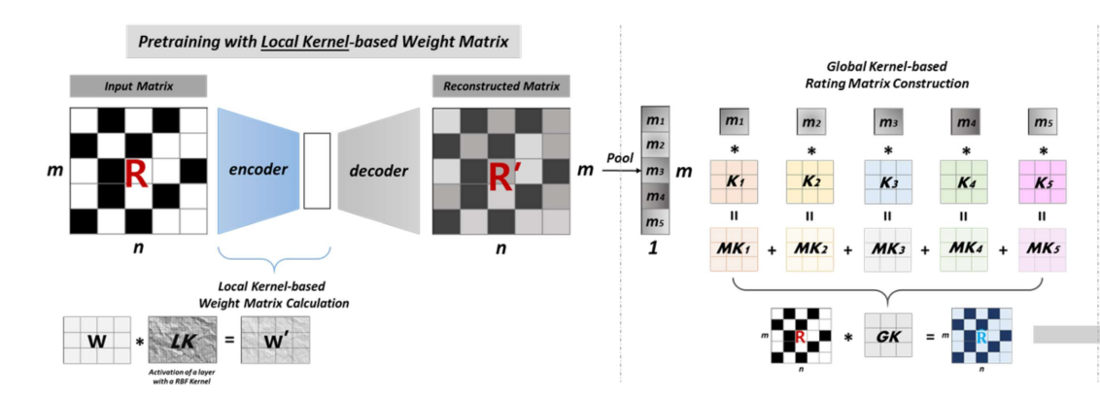
Diagram of intermediate stage

Slide 14
2. Fine tuning with global kernel
Global kerned based rating matrix is given as input to the pre-trained model
The output of the model corresponds to the final predicted ratings for matrix completion

Slide 15
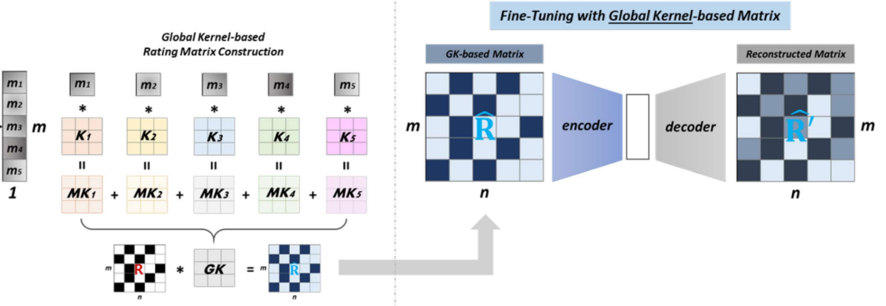
Diagram of stage 2

Slide 16
Experiments
Conducted experiment on 3 datasets: MovieLens-100K, MovieLens-1M and Douban
Compared the RMSE of Glocal with 11 recommendation baselines

Slide 17
Hyperparameters
500 dimensions for AE
2 hidden layers
5 dimension vectors for RBF kernel
3 by 3 global convolution kernel

Slide 18
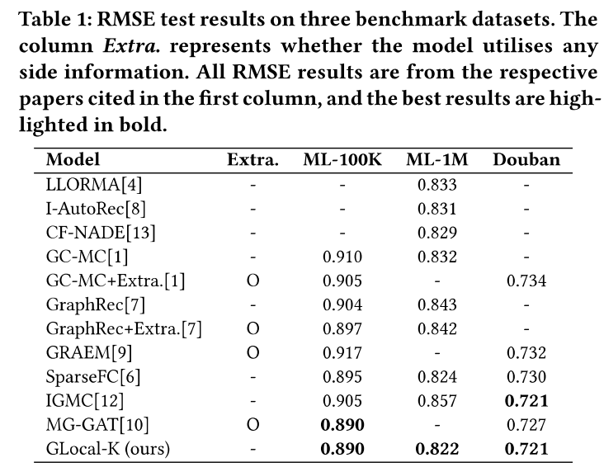
Results-comparing RMSE

Slide 19
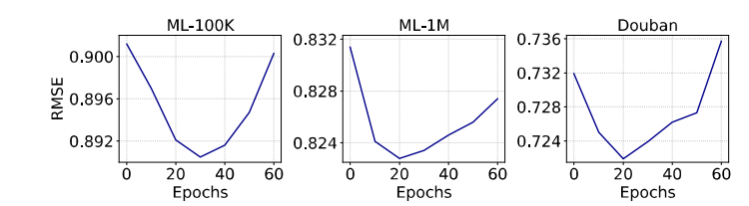
Performance comparison on the no of epochs

Slide 20
Thank You

